Slide 1
Assignment 3 Presentation
Riya Chandaria
Notes:
Welcome everyone to my presentation on assignment 3! 😊

Slide 2
Outline
Defining the problem
Pre-processing the data
An overview of the data
Model building
Evaluating the model
Counterarguments
Conclusion
Notes:
In my presentation today I will be covering:
How I defined the problem
The pre-processing I conducted on the data
An overview of the data
The models which I built from this
How I evaluated the models
Any counterarguments about my findings
And Finally a conclusion of the project

Slide 3
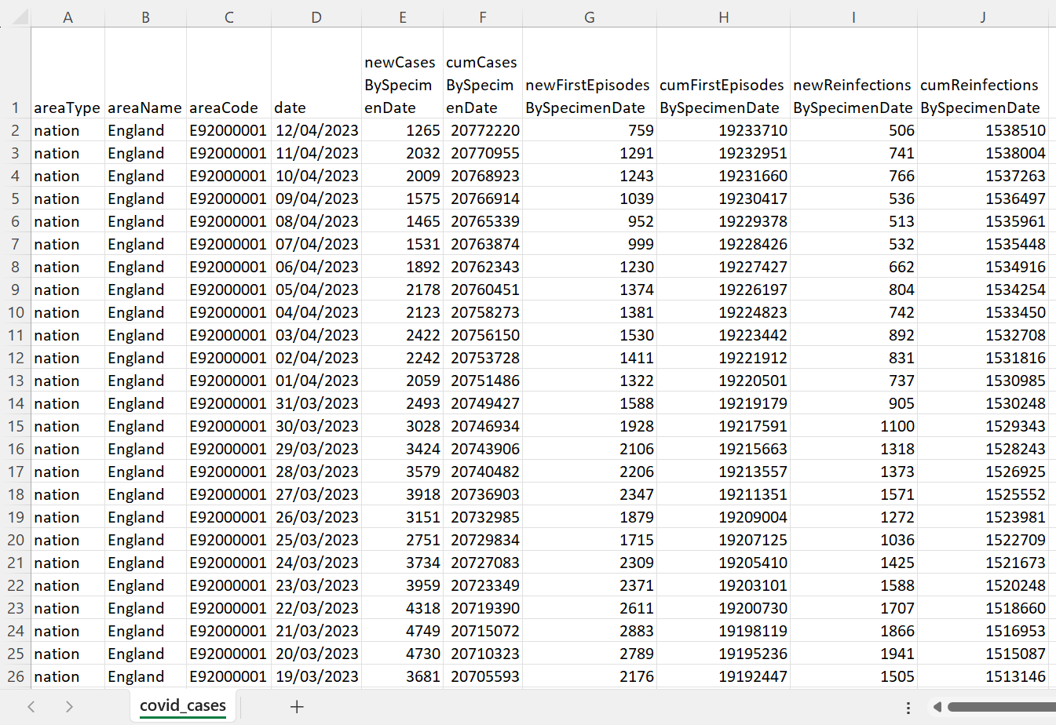
Defining the problem
Chosen dataset: COVID-19 Cases in England
Source: https://www.gov.uk/
Notes:
I chose to research into how the number of COVID-19 cases has changed since the beginning of COVID on 30th March 2020, up until the 12th April 2023.
I took an interest in looking at the COVID case figures during the lockdowns, to see whether the case rate was increasing or decreasing. I would watch the news every evening just to look at the case figures.
The dataset looks like this (point at image). It contains data about the number of new infections, first episode infections and reinfections. I decided to focus on the number of new infections per day and from this then determine which model would best fit how the number of infections per day has changed over time.

Slide 4
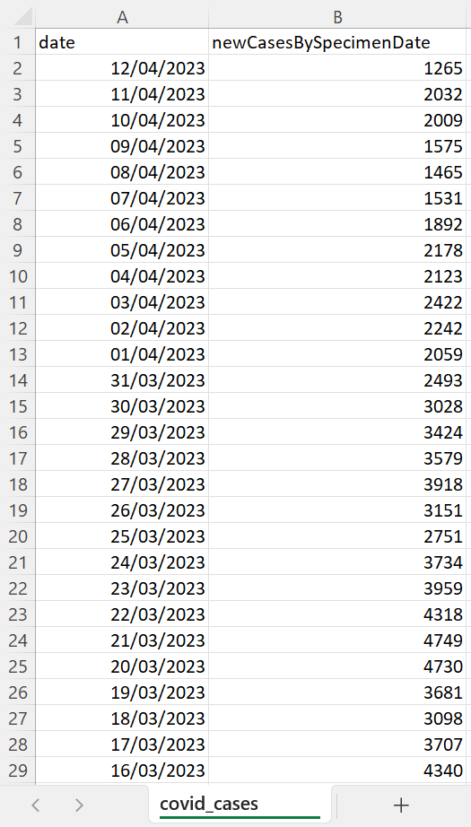
Pre-processing the data
Notes:
I started by performing some basic pre-processing and manipulation.
Firstly, I selected which columns I wanted to be included in my data frame, as seen on the slide. I went with the “date” and “newCasesBySpecimenDate” columns as these would be most beneficial as they provide information about the number of new cases per day.
Secondly, I turned the data frame into an array which made it easier to plot the data later on.
Next, I had to reorder the data. In the CSV file they were stored with the oldest date at the bottom and the newest date at the top. I reordered it by using this line of code (point at code) which reverses the list of data.
From this, I then produced several graphs which help to find which model best fits all the data and a section of the data.

Slide 5
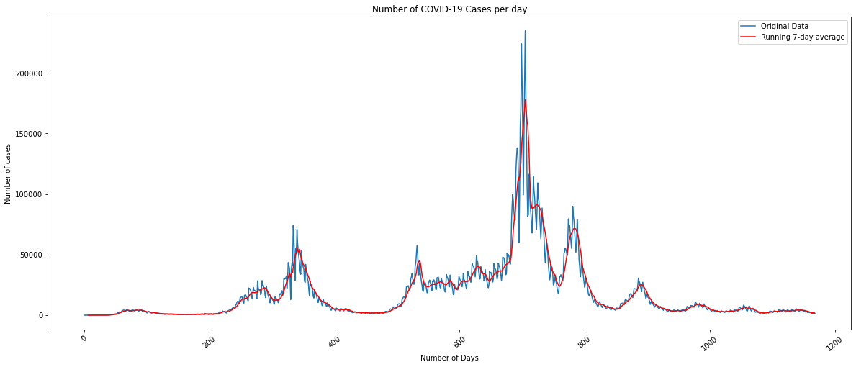
An overview of the data
Notes:
After pre-processing I started by plotting the entire data frame, as seen here (point at graph).
It shows the number of COVID cases per day between 30th March 2020 and 12th April 2023.
From this, we are able to clearly see there are five peaks, with the highest peak of 220,000 cases at about 715 days from the start (point).
The first of the peaks of 75,000 cases at 300 days saw a rapid decrease in cases, down to 3,000-6,000 cases per day, due to the implementation of a national lockdown which meant the virus couldn’t spread as easily.
As lockdown was eased off, the number of new cases began to grow from 525 days, until 700 days when the number of cases grew exponentially. This brought about new measures (e.g. face masks, COVID passes, vaccines, and testing) which helped to reduce the number of new cases.

Slide 6
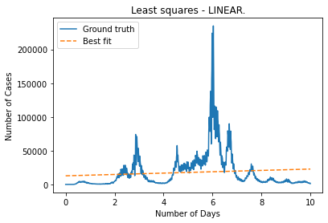
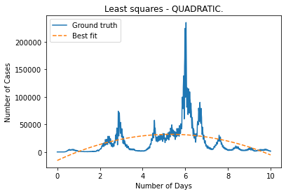
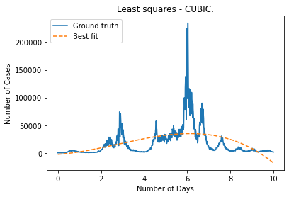
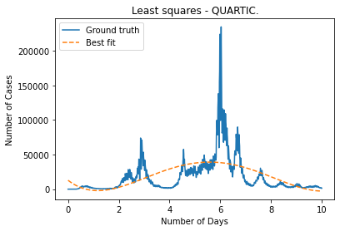
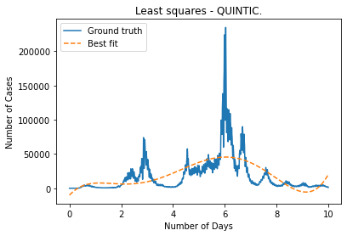
Model Building
Best fit parameters:
a = 109 ± 13
b = -2429 ± 269
c = 16119 ± 1790
d = -28463 ± 4398
e = 12828 ± 3171
Notes:
From this, I then began to see which type of model would best fit all the data.
I chose a quartic model as when comparing the cubic, quartic and quintic models, the cubic model was slightly underfitting the data whilst the quintic model is slightly overfitting the data. This can be seen on the tails of the cubic and quintic graphs (point at the tails).
I also calculated the best fit parameters (point at the slide) which demonstrate that there is a reasonable fit between my model and the dataset as all of the values including the error values seem reasonable.

Slide 7
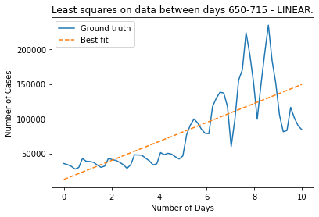
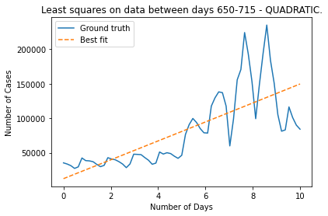
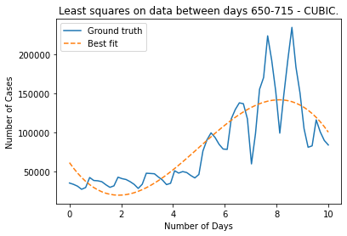
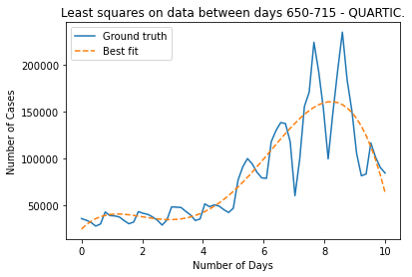
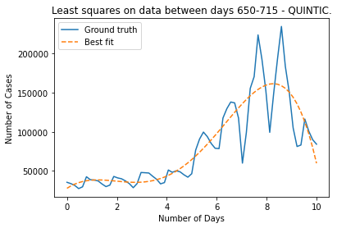
Model Building
Best fit parameters:
a = -288 ± 61
b = -4726 ± 1240
c = -21376 ± 8222
d = 32755 ± 19993
e = 24184 ± 14195
Notes:
My findings about the quartic model being the best suited model for this dataset are also shown when zooming in to a specific range in the dataset.
I chose this range to be the lead-up to the highest peak in the number of cases between the 650th and 715th days.
Again, as we can see, the tails of the cubic and quintic graphs are slightly underfitting and overfitting the data respectively.

Slide 8
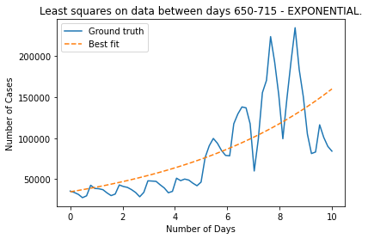
Model Building
Best fit parameters:
x = 3.45e⁴ ± 5.68e³
y = 1.53e⁻¹ ± 2.15e⁻²
Notes:
For fitting an exponential model to the dataset, I decided it would be best to fit the model to the smaller section of the data, between the 650th and 715th days, where the growth of cases is the quickest.
I also calculated the best fit parameters (point at the slide) which demonstrate that there is a reasonable fit between my model and the dataset as all of the values including the error values seem reasonable.
I didn’t fit an exponential model to the entire dataset, as this wouldn’t be beneficial as there are many ups & downs and different growth rates in the number of cases throughout the time period.

Slide 9
Counterarguments
Sensitive starting and ending values in the model.
Models have a tendency of overfitting the data.
Notes:
However, all models which are fitted to datasets have their disadvantages.
For example, quite a few of the models, when fitted, were quite sensitive to the starting and ending values in the range of data.
Also, the majority of the models I produced tended to overfit the data, which can lead to inaccurate predictions in the future and might not perform as well in the future with different datasets containing the same type of data.

Slide 10
Conclusion
Difficult to find a model which can perfectly fit the COVID-19 cases dataset.
Best fitting model is a quartic model.
Notes:
Overall, the COVID-19 cases in England dataset shows it is very difficult to have a model which perfectly or nearly perfectly fits all the COVID cases recorded in this dataset. There are many peaks and troughs, with different rates of increase and decrease.
However, it is much easy and more sensible to fit a model to a specific section of the data e.g., the rise up to the highest peak between 650-715 days. This then makes it much easier to find the most suited model for the data.
Despite this, I believe the quartic model best fits the COVID cases data, as it has the right balance between underfitting and overfitting the data and it also has reasonable best fit parameters to back this up.
Thank you for listening! 😊

